Slide 1
CHRISTMAS SALES AND TREND ANALYSIS DASHBORD
Clean the data in Power bi Editor
Check Column Quantity
Errors must be 0%
Create location table
Check Model view for both tables(Christmas sales and trends ,and location)

Slide 3
KPIs(Key performance indicator)
Kpis use for checking the goals.
First kpi is for Total customers
Second kpi is for total sales
Third kpi is for Total transaactions
Fourth kpi is for Average of delivery time

Slide 4
SLICERS
First slicer is for product name
Second slicer is for location
Third slicer is for gift wrap

Slide 5
VISUALS
First visual is guage shows the sum of discount amount.
Second visual is donut chart shows sum of transactions id by age groups.
Third visual is funnel shows sum of unit price by event.
Fourth visual is stacked column chart shows count of product id by shipping methods.
Fifth visual is line and clustered column chart shows sum of quantity and count of payment type by customer satisfaction.

Slide 6
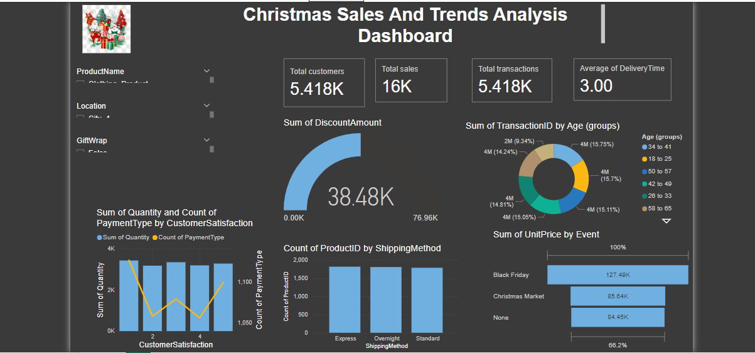

Slide 7
THANK YOU

